Slide 1
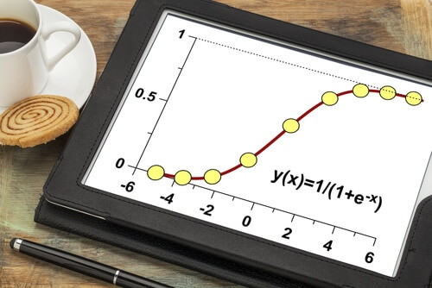
16CSE09 / Machine Learning Techniques
Unit – 2
CO-2: Utilize regression and classification algorithms
Session – 5 & 6
Topics:
Classification
Logistic Regression

Slide 2
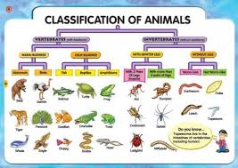
Classification
Classification involves putting things into a class or group according to particular characteristics.
classification refers to a predictive modeling problem where a class label is predicted for a given example of input data.
classify if it is spam or not.

Slide 3
Classification
Classification is technique to categorize our data into a desired and distinct number of classes where we can assign label to each class.
Applications of Classification are:
speech recognition
handwriting recognition
biometric identification
document classification

Slide 4

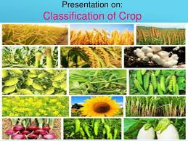
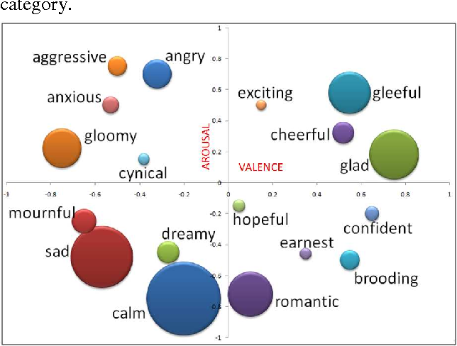
Classifiers can be….
Binary classifiers: Classification with only 2 distinct classes or with 2 possible outcomes
Example: Male and Female; classification of spam email and non spam email; classification of author of book; positive and negative sentiment
Multi-Class classifiers: Classification with more than two distinct classes.
Example: classification of types of soil, classification of types of crops, character recognition, classification of mood/feelings in songs/music

Slide 5
Popular algorithms that can be used for binary classification include:
Logistic Regression
k-Nearest Neighbors
Decision Trees
Support Vector Machine
Naive Bayes
Popular algorithms that can be used for multi-class classification include:
k-Nearest Neighbors
Decision Trees
Naive Bayes
Random Forest
Gradient Boosting

Slide 6
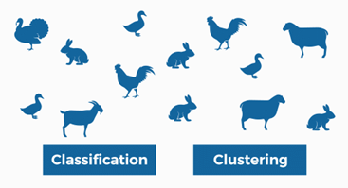
Classification Vs Clustering

Slide 7
Logistic Regression
Logistic regression is a machine learning method used in the classification problem when you need to distinguish one class from another.
The simplest case is a binary classification. This is like a question that we can answer with either “yes” or “no.”
We only have two classes: a positive class and negative class.
Usually, a positive class points to the presence of some entity while negative class points to the absence of it.
Logistic Regression is one of the most commonly used Machine Learning algorithms that is used to model a binary variable that takes only 2 values – 0 and 1.
The objective of Logistic Regression is to develop a mathematical equation that can give us a score in the range of 0 to 1.

Slide 8
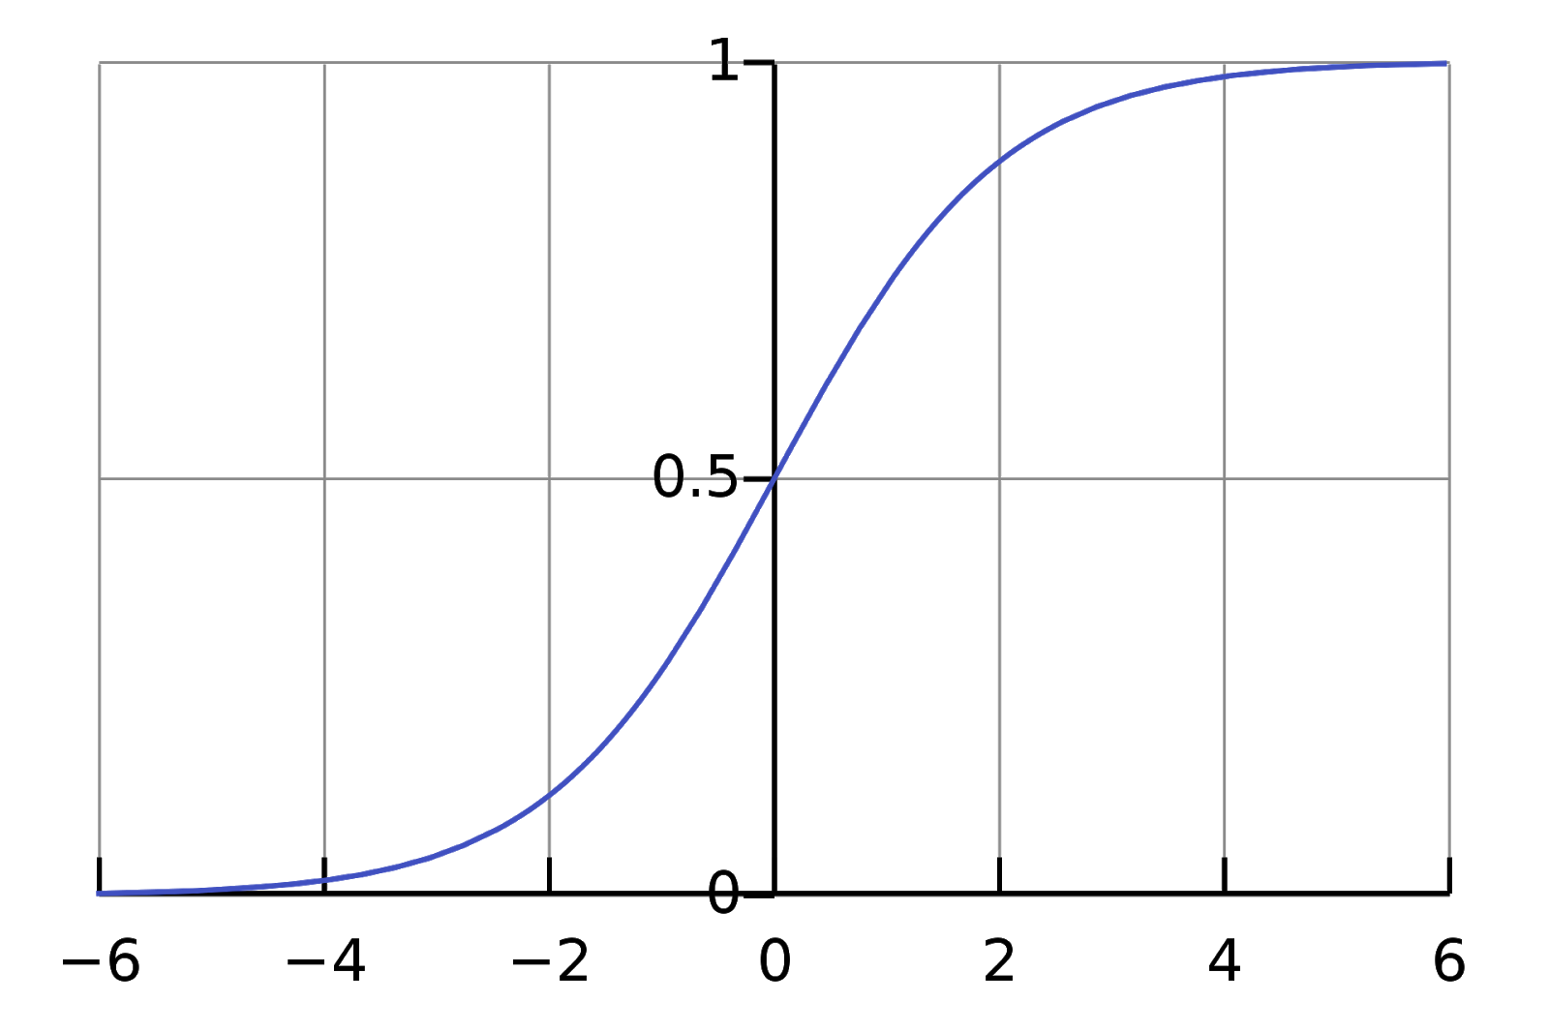
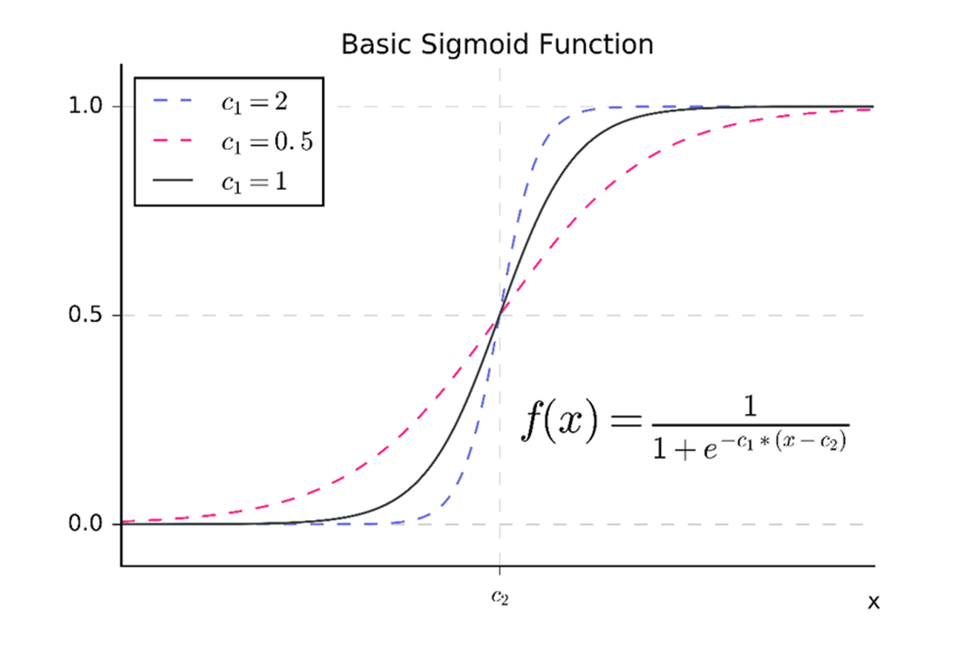
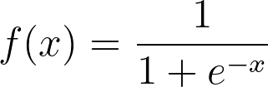
Logistic Regression
to predict a single value - the probability that entity is present.
to have a function that maps any real value to value in the interval between 0 and 1
This is the so-called sigmoid function and it is defined this way:

Slide 9
Logistic Regressions: Application
Spam Detection: is a binary classification problem where we are given an email and we need to classify whether or not it is spam. If the email is spam, we label it 1; if it is not spam, we label it 0.
In order to apply Logistic Regression to the spam detection problem, the following features of the email are extracted:
Sender of the email
Number of typos in the email
Occurrence of words/phrases like “offer”, “prize”, “free gift”, etc.
The resulting feature vector is then used to train a Logistic classifier which emits a score in the range 0 to 1.
If the score is more than 0.5, we label the email as spam. Otherwise, we don’t label it as spam.

Slide 10
Logistic Regressions: Application
Credit Card Fraud: Credit Card Fraud Detection problem is of significant importance to the banking industry because banks each year spend hundreds of millions of dollars due to fraud.
When a credit card transaction happens, the bank makes a note of several factors. For instance, the date of the transaction, amount, place, type of purchase, etc. Based on these factors, they develop a Logistic Regression model of whether or not the transaction is a fraud.
For instance, if the amount is too high and the bank knows that the concerned person never makes purchases that high, they may label it as a fraud.

Slide 11
Logistic Regressions: Application
Marketing
Every day, when you browse your Facebook newsfeed, the powerful algorithms running behind the scene predict whether or not you would be interested in certain content (which could be, for instance, an advertisement).
Such algorithms can be viewed as complex variations of Logistic Regression algorithms where the question to be answered is simple – will the user like this particular advertisement in his/her news feed?

Slide 12
Making Predictions with Logistic Regression
Logistic regression models the probability of the default class.
For example, if we are modeling people’s sex as male or female from their height, then the first class could be male and the logistic regression model could be written as the probability of male given a person’s height, or more formally:
P(sex=male|height)
We are modeling the probability that an input (X) belongs to the default class (Y=1), we can write this formally as:
P(X) = P(Y=1|X)
Note that the probability prediction must be transformed into a binary values (0 or 1) in order to actually make a probability prediction.
Logistic regression is a linear method, but the predictions are transformed using the logistic function. So the model can be stated as: p(X) = e^(b0 + b1*X) / (1 + e^(b0 + b1*X))

Slide 13
Making Predictions with Logistic Regression
Let’s say we have a model that can predict whether a person is male or female based on their height. Given a height of 150cm is the person male or female.
Assume the coefficients of b0 = -100 and b1 = 0.6.
probability of male given a height of 150cm or more formally P(male|height=150)
y = e^(b0 + b1*X) / (1 + e^(b0 + b1*X))
y = exp(-100 + 0.6*150) / (1 + EXP(-100 + 0.6*X))
y = 0.0000453978687

Slide 14
Summary
Classification
Applications of Classification are
Binary classifiers
Multi-Class classifiers
Logistic Regression
Applications of Logistic Regressions

